Slide 1
Action Report
K0PG-Shaft Comp Cam Face Roughness Issue
Reported Date ： 2022/FEB/28
Reported ： Musashi Auto Parts India Pvt. Ltd
Approval
Check
Issued
Sawada / Umashankar
Prashanth
Ujjal /Abidali

Slide 2
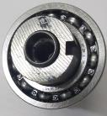
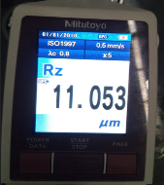
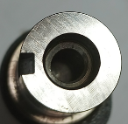
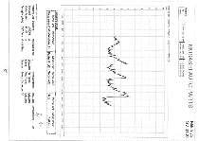
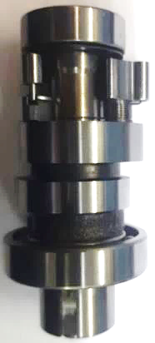
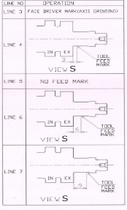
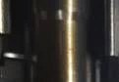
Problem Description
PROBLEM DETAILS
Issue: | Face Surface Roughness issue
Model: | K0PG
Part: | Shaft Comp Cam
No Of Cases: | 1
Date: | 05.02.2022
CLAIM PART
OK PART
Spec:12.5 Rz max
Act: 11.053
Spec:12.5 Rz max
Act: 7.286
LINE IDENTIFICATION
SEGREGATION DATA
Location | Checked | OK | Suspected (Visual) | Remarks
Map-ID Gujrat | 3,458 | 3,442 | 16 | Rz is Ok, There is Visually difference available.
Map-ID Bangalore | 2,500 | 2,488 | 12 | Rz is Ok, There is Visually difference available.
Total | 5,958 | 5,930 | 28
Line Mark on the Dia 13
Identification is Line 6
Roughness Observed in Higher Level and Part belongs to Line 6 according to Identification mark

Slide 3
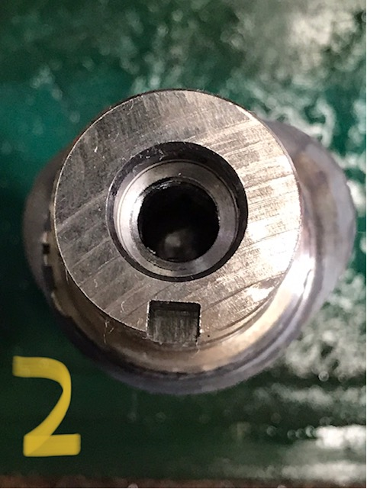
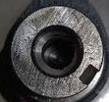
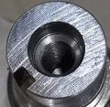
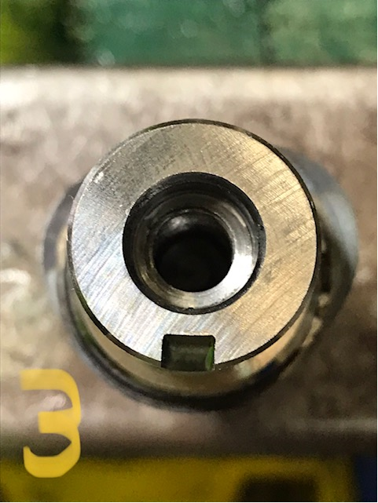
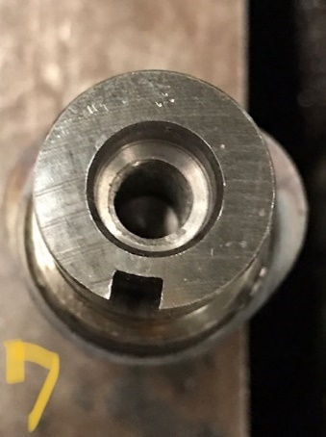
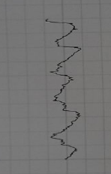
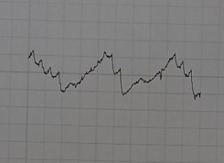
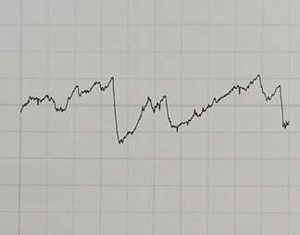
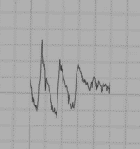
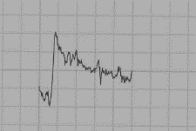
Visual Suspected Parts Face Roughness Data.
Sample reports
9.661
9.685
11.578
9.573
10.096
Visual suspected parts checked and found in the range of 9.661 Rz~11.578 Rz

Slide 4
Lot Traceability
Observed No Change point on Suspected Batch 11035201 made on between 19th Jan to 20th Jan 22

Slide 5
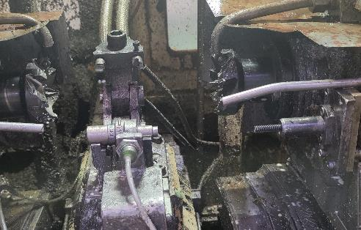
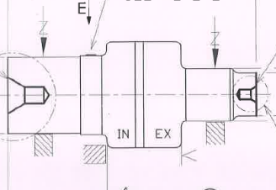
Process Flow
Shaft Comp Cam Process Flow
Occurrence
Outflow
Shaft Cam
Receiving Inspection
Centering and Facing
Turning 1
Turning 2
Drilling Reaming & Tapping
Keyway Milling
Cam Milling
Induction Hardening & Tempering
Axis Grinding
Part For Assembly
Final Inspection
Lapping
Buffing
Milling, Drilling & Reaming
Cam Grinding
Shaft
Comp Cam
Receiving Of Finished Part
Child part Manual Assy
Bearing Pressing & Pin Dowel Assy
Final Inspection
Oil Application
Facing Tool
Coolant Supply
Facing
Facing
Centring
Centring
Cantering Tool
Part
Suspected process is Centering & Facing for Occurrence & Outflow

Slide 6
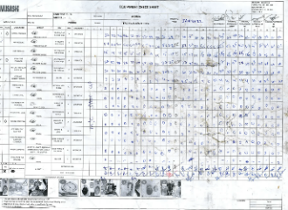
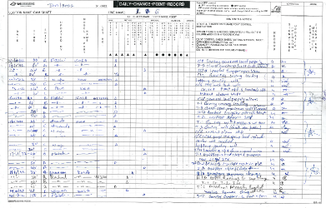
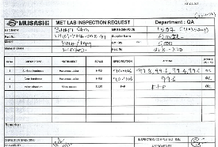
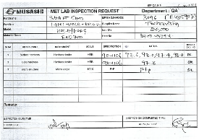
Change point Record (4M) Occurrence
4M | PARAMETERS | CHECKING METHOD | ACTUAL | STATUS
M (Man) | Skilled Operator at critical stations Skill of inspector at Q check gate Rule Adherence | Attendance records Manpower fixation sheet Skill matrix Judgement skills | No Change Point | ⃝
M ( Machine ) | Change in Machine Change in machine program Major breakdown /maintenance Wear parts condition | Maintenance records All Poke-yoke implementation & controls of machine Change point control/ Log book Gemba verification | No Change point | ⃝
M (Method ) | Tool life Monitoring Tool Life Control Inspection Method insufficiency | PQCS revision Work instructions Rule root/procedure Vs Actual (By check sheet/record) Gemba Verification | No Change Point | ⃝
M (Material ) | As per PQCS Change in Sub supplier | PQCS Approved sub supplier list | No Change Point | ⃝
TPM Sheet
Change Point Record
Hardness Data
⃝
⃝
⃝

Slide 7
Occurrence Cause
Factor Analysis
SI NO | FACTOR | CONFIRMATION POINTS | INSPECTION CRITERIA | OBSERVATION / IMPROVEMENT POINTS | JUDGE
1 | MAN | Skill Level | Observed As per requirement | Skill Level found OK | ○
2 | MACHINE | Clamping Condition | Clamping Pressure Spec 20-30kg/cm2 Verified the Equipment Check sheet | Act:27kg/cm2 | ○
3 | MACHINE | Clamping Condition | Wear Parts should be in OK condition | Tool Clamp condition is OK | ○
4 | MACHINE | Slide Movement Condition | To be smooth | There is no issue Mentioned, At present condition also OK | ○
5 | MATERIAL | Material Hardness | Material Hardness to be as per Spec | Found OK | ○
6 | METHOD | Tool Condition | OK Inserts to be used, Turret condition to be OK | All Condition found OK | ○
7 | METHOD | Tool Life | Tool life to be as per Process Sheet (1200/edge) | Found OK, Appearance-wise seem to be not OK, (Insert End time Roughness in towards higher) | ○
Occurrence-Why Why
Why 1 | Why 2 | Why 3 | Why 4 | Why 5
Surface roughness higher at Insert Life End | Insert Performance deteriorated at End life | Set parameters are inadequate to keep the surface roughness in Mean Level | Parameters freeze to the maximum to optimize the Cycle time | Optimized cycle time for line balancing.

Slide 8
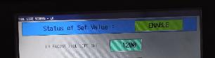
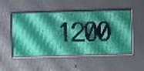
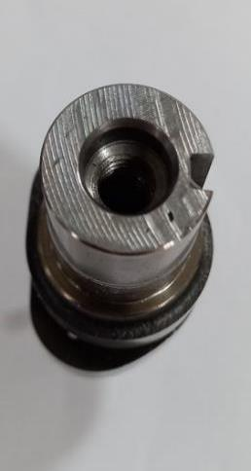
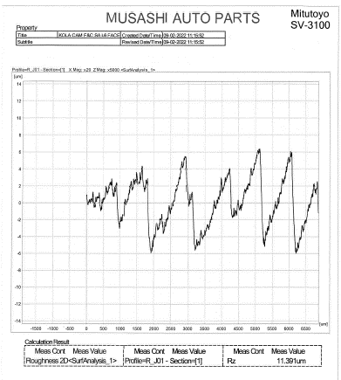
Occurrence Cause-Simulation
Tool Life Set for the Line 6
Cam Shaft surface image at end of the tool life
CYCLE TIME OPTIMISED CONSIDERING TOOL CHANGING TIME AND LINE BALANCING.
Part Surface roughness Report
11.39 Rz
At 800life 10 Rz
At Higher Side
Based on the life monitoring simulation surface finish actual observations are close to the limit.

Slide 9
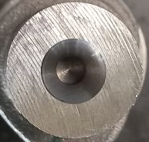
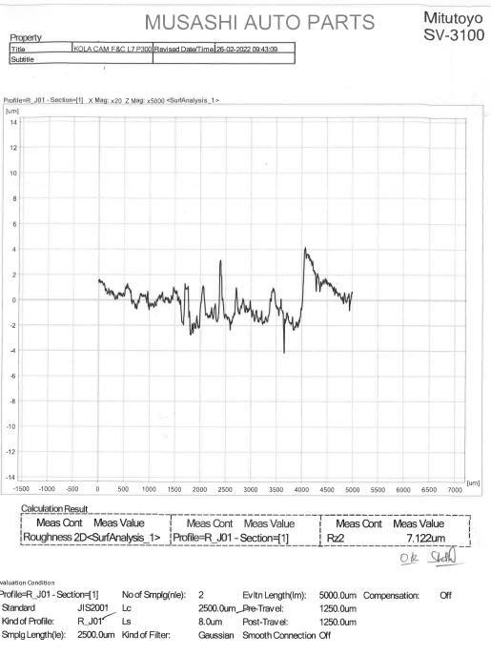
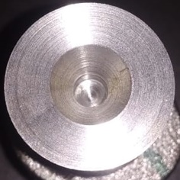
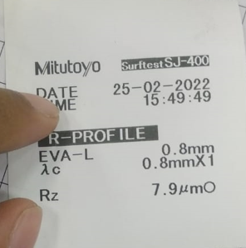
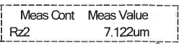
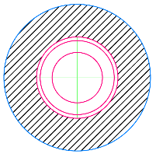
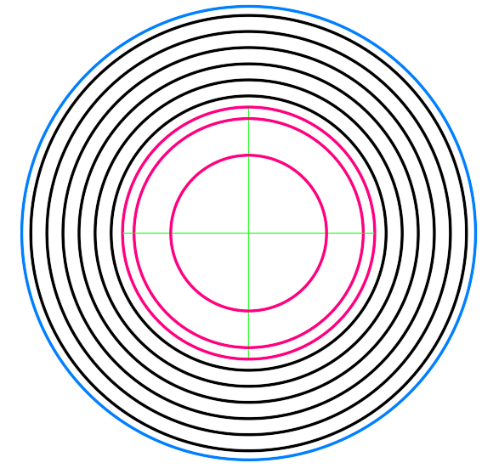
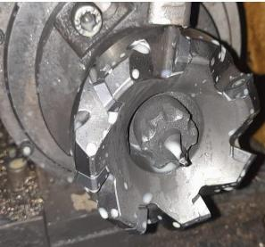
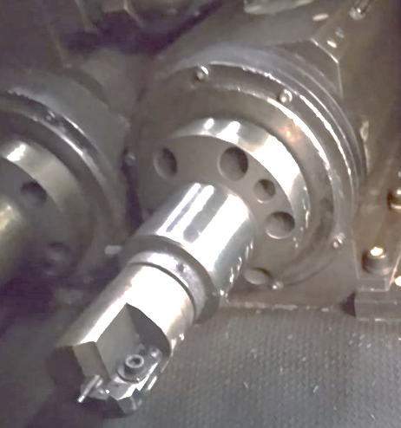
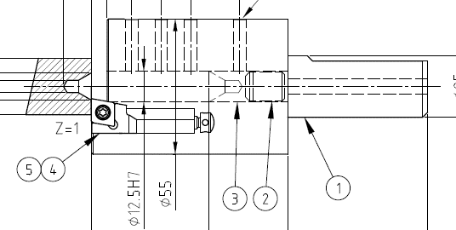
Bawal Vs BLR Face Roughness Difference.
SL No | Parameter | MAP BLR | MAP BWL
1 | Cutter Type | SPL milling cutter | Cartridge
2 | Insert Type | SDHT1204 | CCMW
3 | No of Insert | 7 | 1
4 | Cutting Type | Thru Feed | Infeed
5 | Machine Type | SPM Infeed –CNC, Thru Feed-Hydraulic | SPM -Hydraulic
6 | Feed Mark Appearance and Roughness Report
7 | Tool Image
8 | Remarks | Drill depth & Length control thru Offset- easy to maintain | More Skill based as no separate control available for drill depth & Length
Drawing Spec.12.5Rz

Slide 10
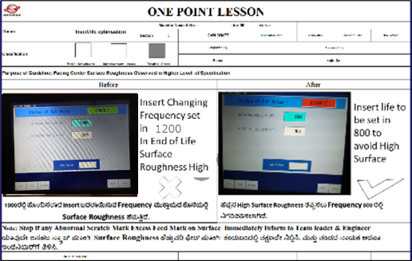
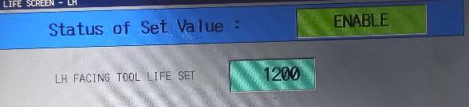
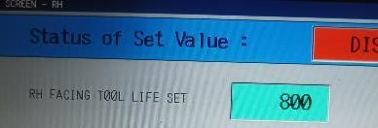
Improvement action
Root Cause | Action | Resp | Target | Status
Occurrence: Optimized cycle time for line balancing. | Immediate Action 1 : Insert Indexing frequency further reduced and set to 800 / edge | Abid Ali | 06.02.2022 | ○
 | Permanent Action: New insert trial to be initiated to improve the Surface roughness | Sajin | 31.03.2022 | △
Line wise OPL Displayed on insert life set
BEFORE
AFTER
Immediate actions taken and Permanent action Planned

Slide 11
Outflow Cause
Factor Analysis
SI NO | FACTOR | CONFIRMATION POINTS | INSPECTION CRITERIA | OBSERVATION / IMPROVEMENT POINTS | JUDGE
1. | MAN | Skill Level | Observed As per requirement | Skill Level found OK | ○
2. | MATERIAL | Material Hardness | Material Hardness to be as per Spec | Found OK | ○
3. | METHOD | Checking Method | Check method as per process sheet | Check method in roughness tester | ○
4. | METHOD | Check point | Visual inspection as per standard | Standard inadequate / no checkpoint. | X
5. | METHOD | Checking Frequency | Checking Frequency as per process sheet | Frequency F/shift, Setting approval & tool change | ○
Outflow-Why Why
Why 1 | Why 2 | Why 3 | Why 4 | Why 5
Defect skipped for Q gate | Judgement not done properly | Understanding gap fo surface finish | Guideline line to operator inadequate | Limit sample / other visual aids not provided.

Slide 12
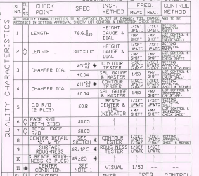
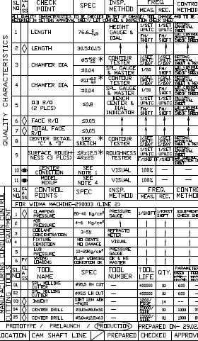
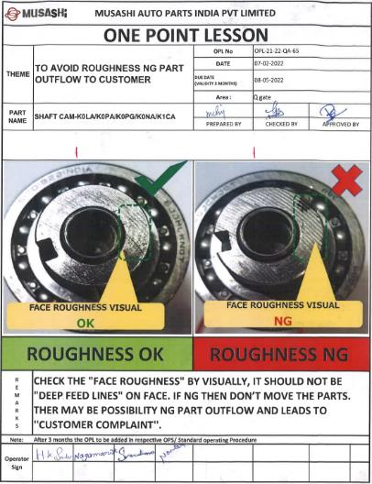
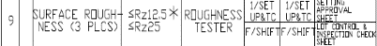
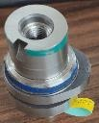
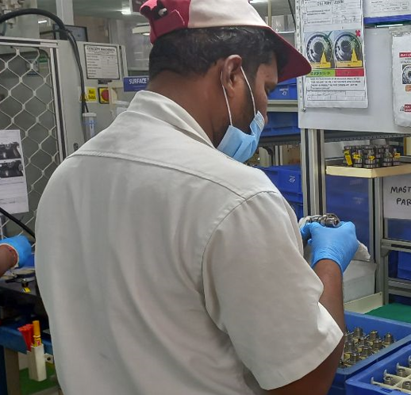
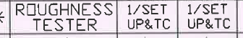
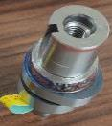
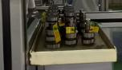
Outflow Improvement Action
Root Cause | Action | Resp | Target | Status
Outflow Limit sample / other visual aids not provided. | Surface roughness Check frequency improved to F/Shift | Praveen ME | 17.02.2022 | O
 | Limit Sample provided for easy identifying the defects | Giridhar QA | 17.02.2022 | O
Process-Outflow
Final Inspection
BEFORE
AFTER
Limit Sample
OK
NG
Before | After
Rz Checking Frequency 1/Setup & Tool Change | Rz Checking Frequency 1/Setup, Tool Change & Shift Start
Limit Sample
At Station
Outflow Control improvement Action taken under monitoring

Slide 13
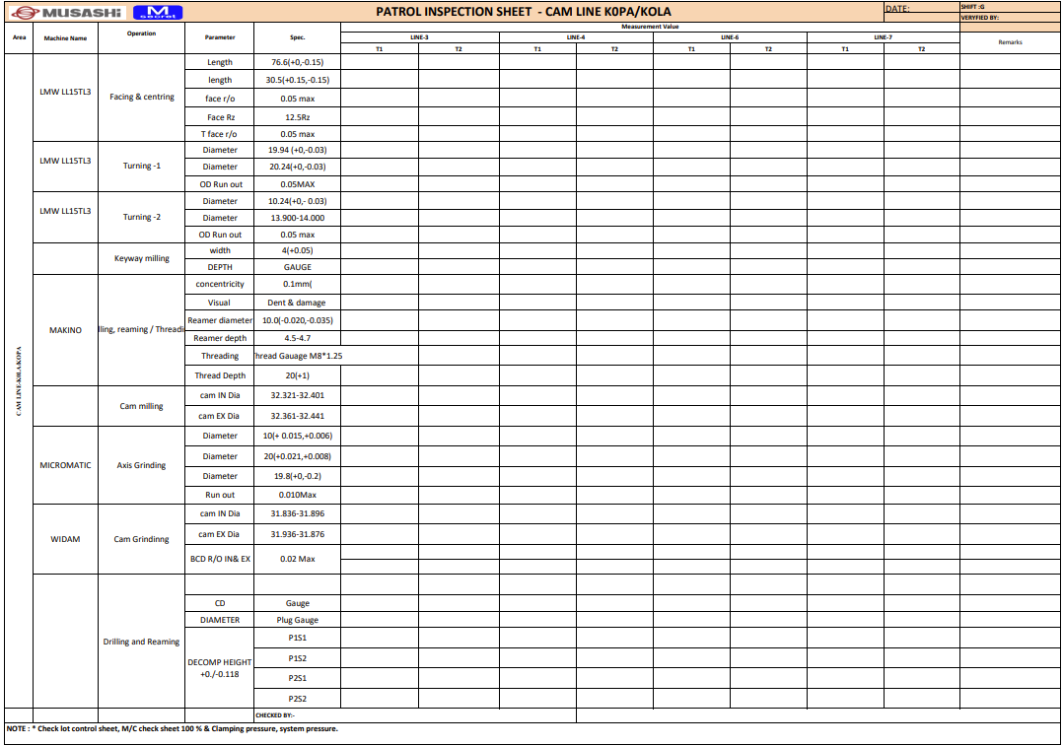





System Actions
Sl No | Activities | Resp. | Status
01 | Process sheet change for the Rz Monitoring ShiftWise | Shift wise line leaders | O
02 | Insert Life Monitoring Sheet | Production & QA | O
03 | In process ShiftWise monitoring the Surface Roughness | Shift in process associate | O
04 | Monthly Verification the actions at occurrence and outflow | CQA Team | O
05 | FMEA Revise by recommendation Actions | ME | O
1
3
In process ShiftWise monitoring
4
Process sheet change for Rz Checking Frequency 1/Setup, Tool Change & Shift Start
2
Monthly Verification
5
Insert Life Monitoring Sheet
FMEA Revise
Actions will initiate horizontally and will completed as per the target date.
Other Action will Horizontally diployement after implement.

Slide 14
Horizontal Deployment
Areas | Countermeasure Horizontal Deployment | Line To be Implemented
 |  | Q Gate -Process | Q Gate-Final | Line-3 K0PG | Line-4 K0PG | Line-7 K0PG
Occurrence | Insert Indexing frequency further reduced and set to 800 / edge | ----- | ---- | O | O | O
Outflow | Visual Checkpoint added at process and final inspection. | O | O | -- | -- | --
 | For easy identify limit sample provided at the Q Gates | O | O | -- | -- | --
Actions will initiate horizontally and will completed as per the target date.
Other Action will Horizontally diployement after implement.

Slide 15





Management Action
Sl No | Purposes/Reason | Activity | Status
01 | Problem in identifying NG parts due to lack of awareness | Training and Awareness - Defect surface roughness added in the defect part information table implemented for awareness to all members. | O
02 | Gap available for effectiveness of training provided for NG part identification | NG Part Identification skill validation Poision(IZIWARU) test has been initiated for all lines with frequency-based plan by adding surface roughness. | O
03 | Knowledge lacking in new joiners w.r.t company requirements. | NG Part Awareness – Educating associates with video display in GEMBA | O
04 | To straightening Visual inspection | Limit Sample Availability Check and provide limit samples at Q-Gate as required to easy identification. | O
05 | To avoid Mis communications | Regular Basis Verification Processes under CCTV Surveillance. | O
1 Defects information
3 Education By Video Display
1
3
Assy
2
2. IZIWARU Test
4. Limit Sample
4
OK
NG
5. Processes under CCTV Surveillance.
5
Actions are initiated and effectiveness under monitoring

Slide 16


Past Trouble Summary
SL No | Report Date | Part Description | Problem Description | Defect Photos | Root cause | Major Action | Status
01 | 24.09.21 | K0P Cam Shaft | Keyway Length Less |  | Occurrence : Keyway Length Less Due to Slide forward movement limit switch dog screw loosed, Outflow : Checkpoint not available | Occurrence : Checkpoint Added in PM sheet Outflow : 1.Checkpoint added in SOP 2.Limit Sample Provided. | O
02 | 10.12.21 | K0P Cam Shaft | Reamer Operation Missed |  | Occurrence. Premature Failure of Jaws Outflow Less awareness on the judgement procedure after alarm No Past Experience. | Occurrence 1.Life to be Re Established by considering premature failure. 2.Clamping pad is changed from brass to steel. 3.Alarm resetting procedure readdressed for effectiveness. Outflow 1. Standard procedure modified for alarm Judgement parts 2.SOP Made for the Alarm handling Parts. 3. POKA YOKE to be implement to detect while Grinding OD Check | O
03 | 05.02.22 | K0P Cam Shaft | Face Surface Roughness issue |  | Occurrence. Optimized cycle time for line balancing. Outflow Limit sample / other visual aids not provided. | Occurrence Immediate Action 1 : 1.Insert Indexing frequency further reduced and set to 800 / edge Permanent Action: 2.New insert trial to be initiated to improve the Surface roughness Outflow 1.Surface roughness Check frequency improved to F/Shift 2.Limit Sample provided for easy identifying the defects | 1) O ∆ O O
CLAIM PART
NG
OK

Slide 17
Other Actions Initiated for eliminate the issues
Problem | Activity | In Charge | Target Date | Status
Keyway Length Less | Sprocket Gauge Modification to capture Keyway length less parts to outflow | Praveen /Abidali | 12.01.2022 | O
Reamer Missed | 1.Process Sequence changed As per Bawal (Before Drill-Tap-Reamer After-Drill – Reamer-Tap) 2.POKA YOKE Pin at Robo drill at output (Maker visit planed on Monday) 3.POKA YOKE at Assy Inspection Gauge 4.Rework SOP Revised and following | Praveen –ME Praveen-ME Seema/Sathish Seema | 13.01.2022 28th Feb 22 20.12.22 01.02.22 | O ∆ O O
Roughness | 1.Tool life established based on Roughness Values 2.Machine Basic condition checking with the help of maker 3.New Insert trails. | Praveen-ME Praveen-ME Praveen -ME | 06.02.22 28th Feb 30.03.22 | O ∆ ∆
Immediate Actions are initiated and permanent actions are planed

Slide 18
Effectiveness
1.Insert Indexing frequency further reduced and set to 800 / edge
2.Checkpoint added at Process & Final Inspection
Further Effectiveness are under monitoring.

Slide 19

THANKS

